Slide 1

Team 5: GearOnTheGo
Iteration(3)
By: Ahnaf Tajwar, Jian Song, Lazaro Perez, Saahil Vashishta, Samantha Mathis, Shajee ur Rehman

Slide 2
Summary of Iteration 0
Objectives and Priorities
Login Feature
Database
Users
Items for rent
Search for Items
View your rentals
View your items
Checkout
Timeframe
Payment
Confirmation
Automatic returns after the end return date
Project Management Our project is a recreational equipment rental service web application. Our vision is to align people who are in need of these recreational equipments, examples include(canoes, kayaks, mountain bikes, boats, jet skis etc), with people who have the equipment readily available for others to use for a specified time. The functionality of the site is to allow users to choose items that are posted by individuals in their vicinity who need these items.
Risk Management
The highest priority risks that we decided were Not enough time for testing and not familiar with the programming language. Some of the lowest priority risks were Improper planning, Duplicate work, Loss of a member, and improper management skills.

Slide 3
Summary of Iteration 1
SDD
Software Architecture
Included folder structure
Backend uses Flask, Frontend uses React, PostgreSQL Database is hosted on ElephantSQL
Class Diagram
7 entities defined currently
UI Design
Initial mockups provided and discussed
Database Design
Tables: equipment, user, paymentinfo, reservation
Security Design
Email and password validation
Design Patterns
Abstract Factory, Observer, Composite

Slide 4
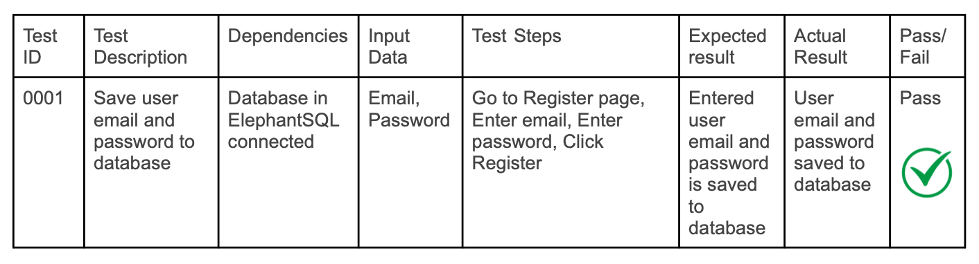


Summary of Iteration 2
STD
Manual Testing
Automated Testing
Unit Testing
Functional Testing

Slide 5
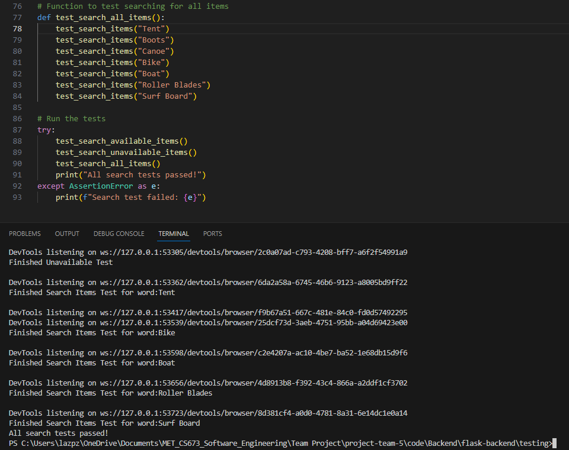
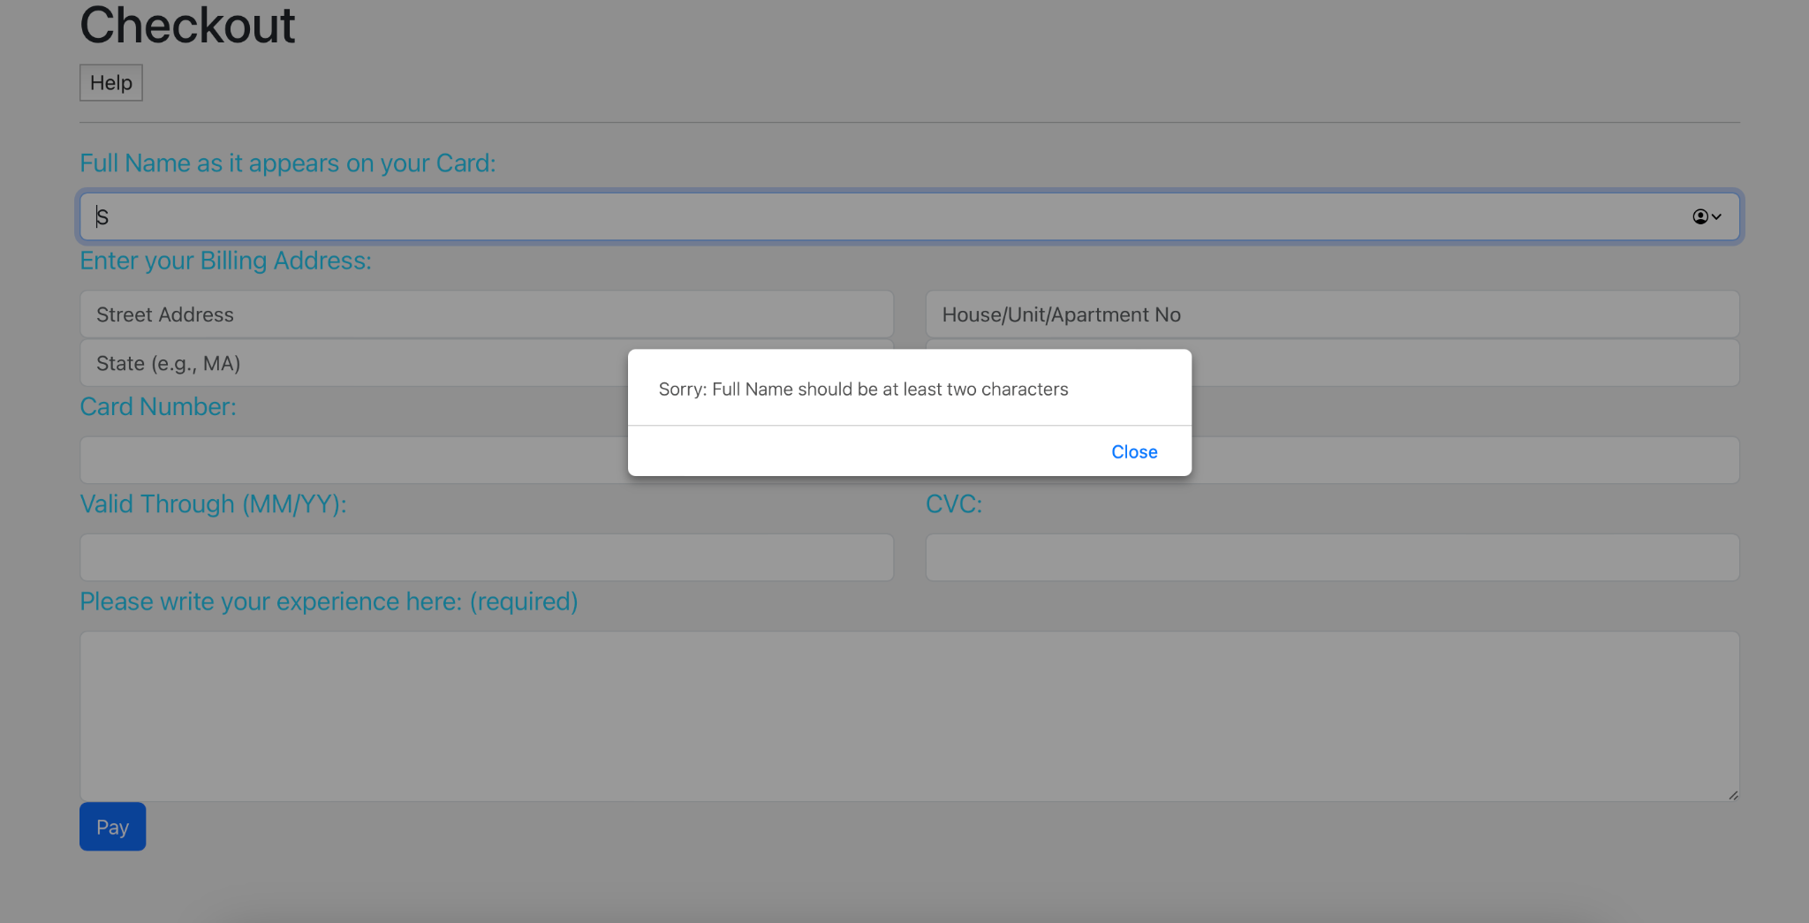
Testing Summary
Login tests executed automatically using Selenium
Google Login test with functional tests
User model tested with unit tests
Search Features tested using Selenium for the Available/Unavailable radio buttons as well as for different search terms
Adding/Removing items tested using Selenium
Making reservations was tested using Selenium
All other features also manually tested

Slide 6
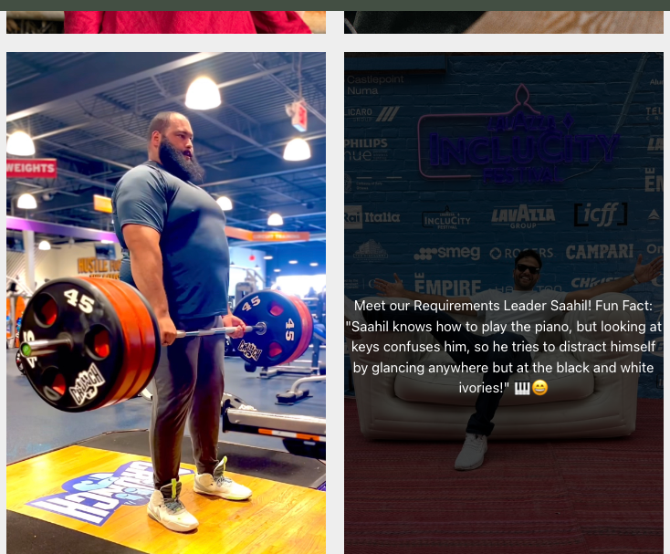
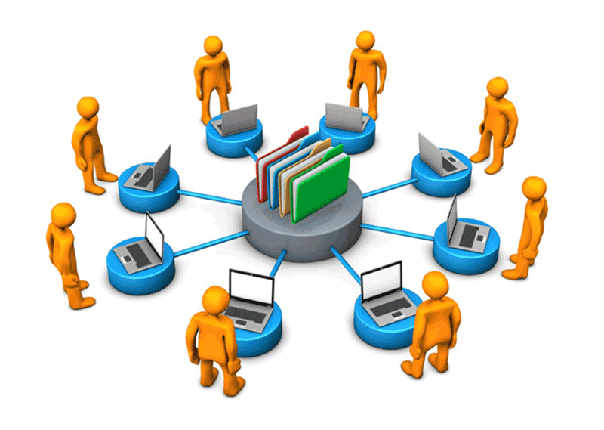
Summary of Iteration 3
This iteration was primarily about focussing on optimizing and further refining the website
The UI was updated to feature a customized navigation bar that is consistent throughout all pages
The Log Out feature was added to ensure that the user’s current session has ended
The Item Search functionality was enhanced to be smoother and work alongside the keyword search
Reserving an Item now required the user to complete the payment process first
An ‘About Us’ page was added which included pictures and fun facts about all Team Members
There was improved error handling and logic implemented on user inputs across all pages
Users can no longer input a card that has expired during the Checkout Process
Some features that were part of the initial roadmap were deprecated due to complexity and time constraints. For e.g: Accepting Reservation Request, Stripe Secure Payment, ID Verification, e-mail notifications, AI Chatbot, Hosting equipment images, FAQ page.
Website was hosted on Heroku

Slide 7
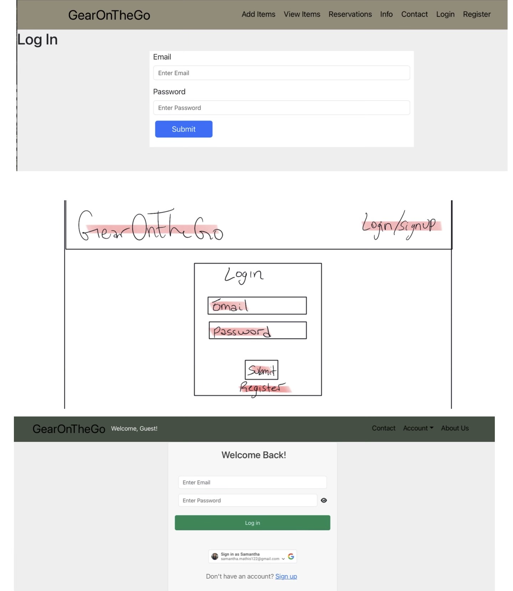
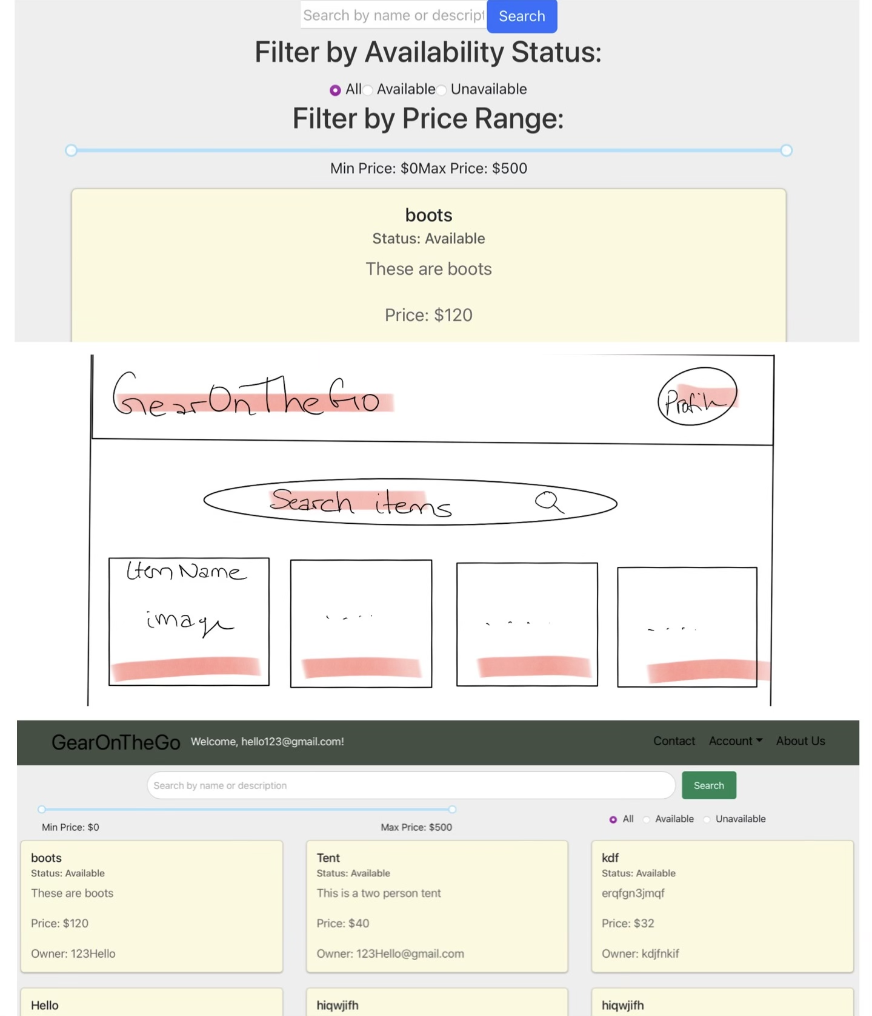
Progression of UI

Slide 8
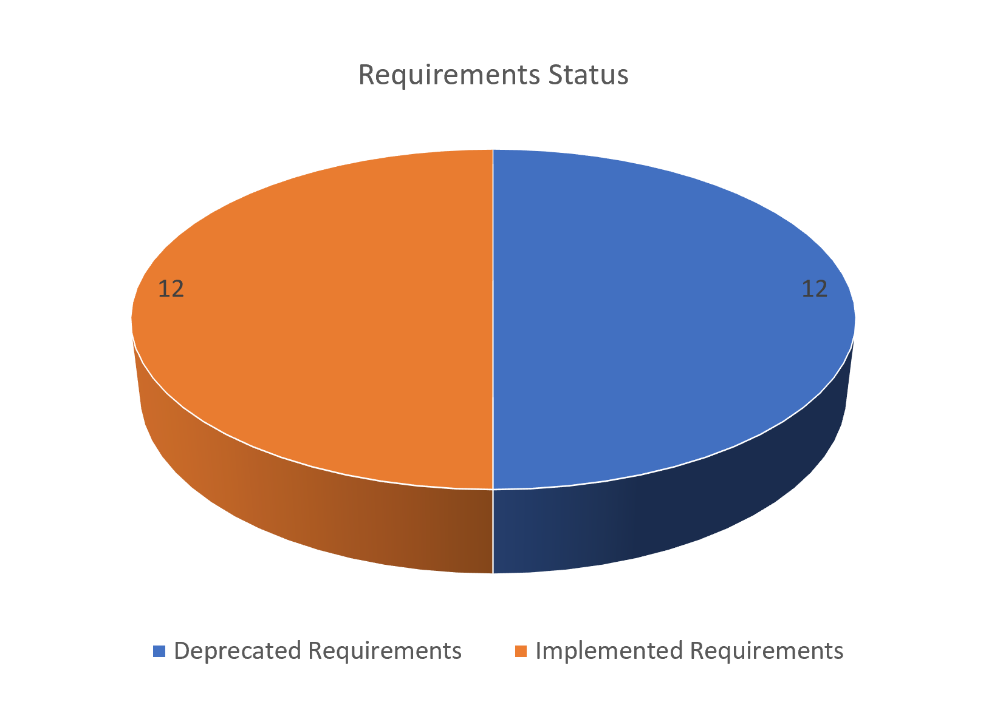
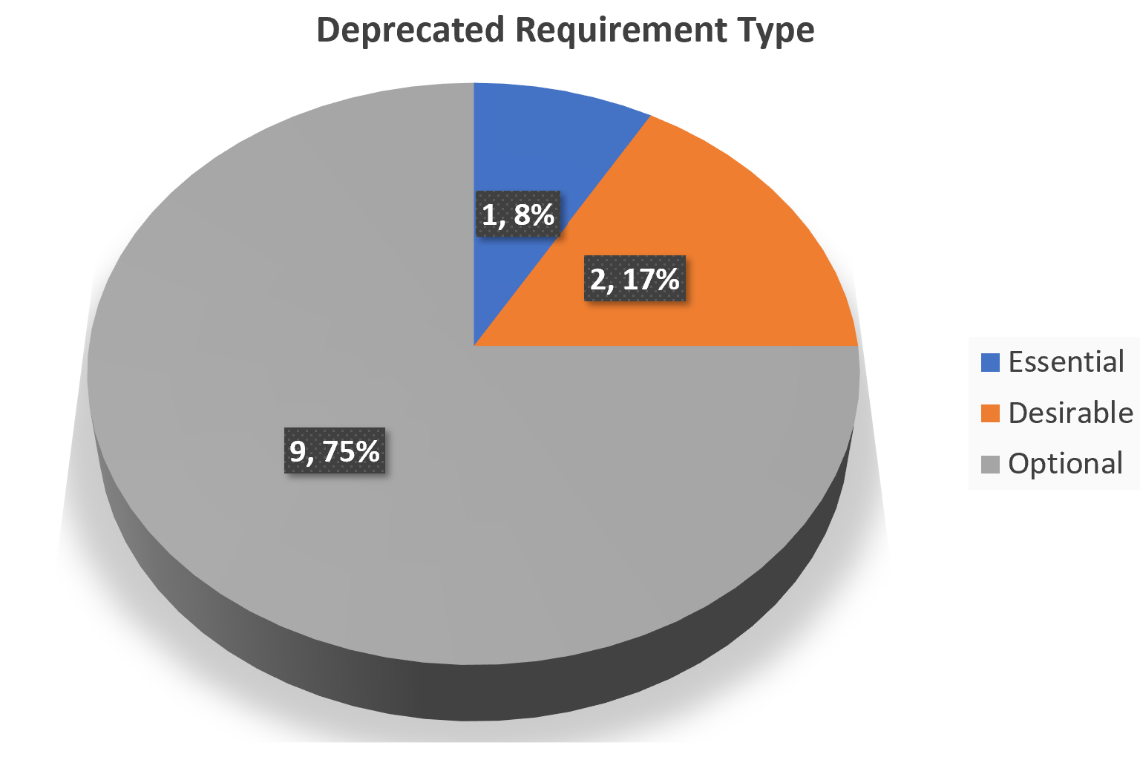
Requirement Analysis
On the right we can observe the following:
There was a 50-50 split of requirements that were successfully implemented and the ones that were deprecated due to scope and time constraints.
Based on the original scope, of the deprecated requirements:
Only 8% of the requirements were essential (1 requirement)
Only 17% of the requirements were desirable
A whopping 75% of the requirements were optional (9 requirements)

Slide 9
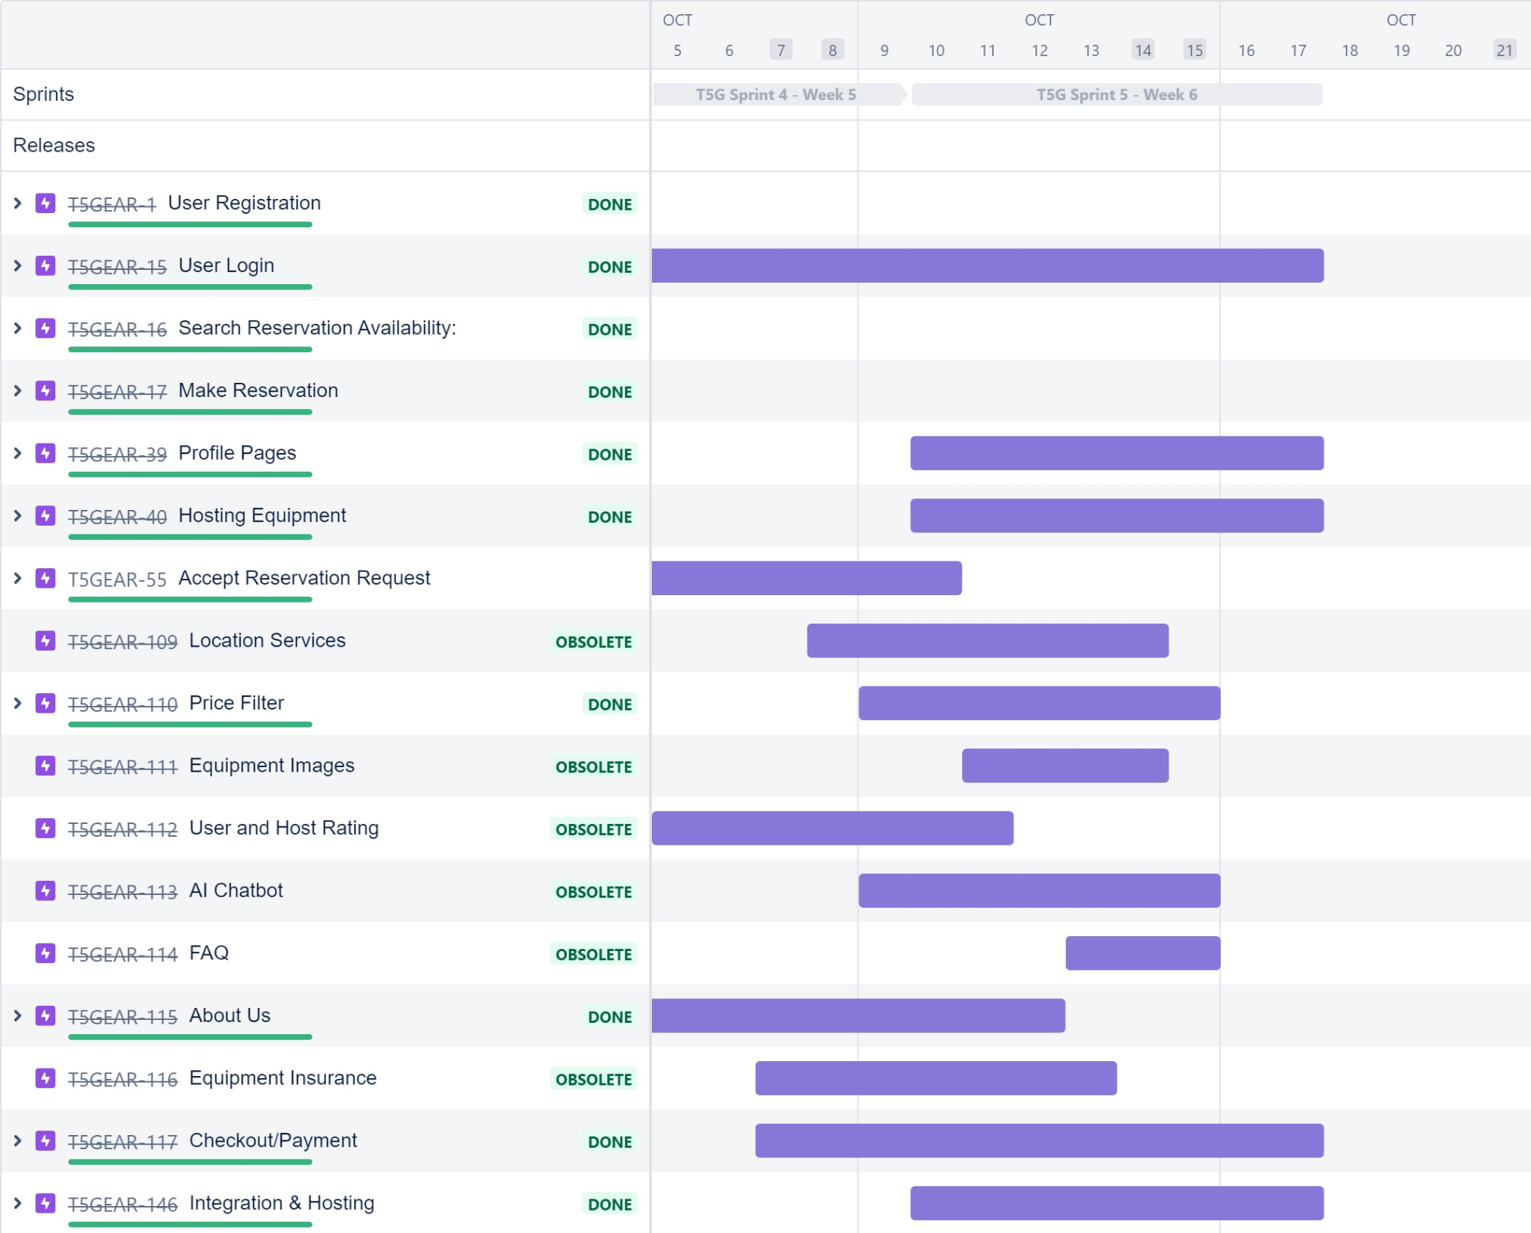

Timeline and completed epics
As discussed in the previous slide, this slide shows the timeline towards the end of the project and status of all the epics created.

Slide 10
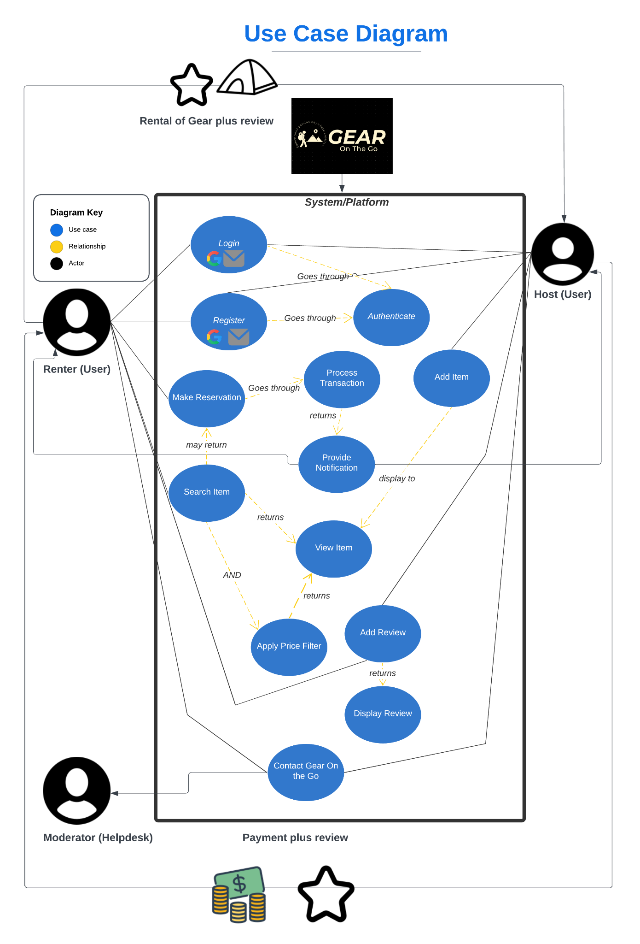
Use Case Diagram
The following image (also posted in the SPPP document) shows the Use case diagram
Following actors:
GearToGo System/Platform
Host User
Renter User
Moderator
Following Use cases identified:
Login
Register
Authenticate
Make Reservation
Search Item
Add Item
Process Transaction
View Item
Provide Notification
Apply Price Filter
Add Review
Display Review
Contact Gear on The Go

Slide 11
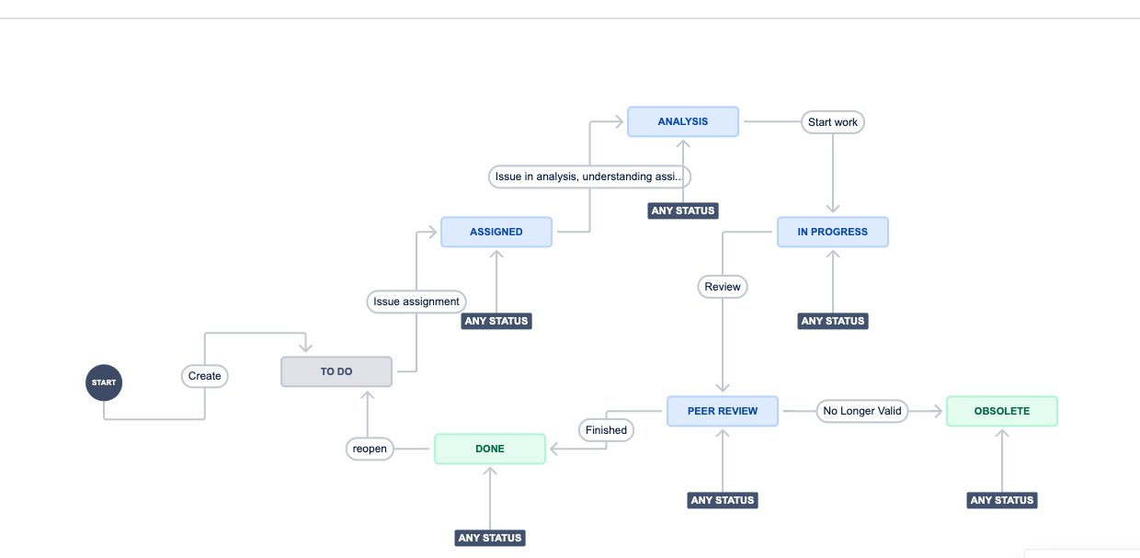
Updating the workflow and deprecating epics
Based on time constraints and the scope of this project several epics and user stories were deprecated
To facilitate the same, workflow in Jira was updated

Slide 12
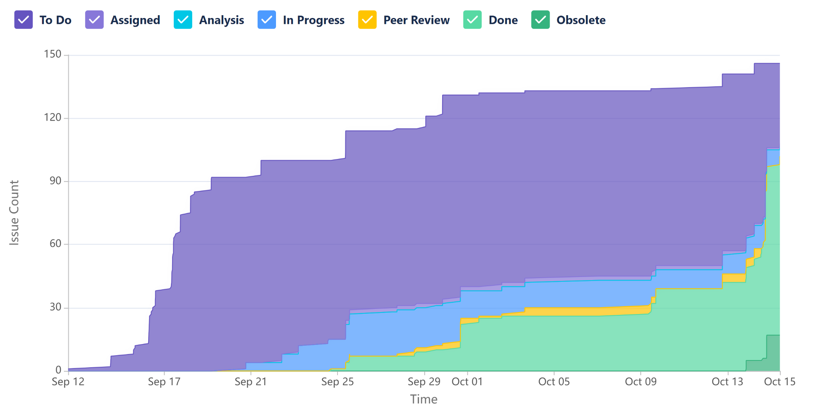
Progress Over Time
The cumulative flow diagram on the right shows the progression of tasks over time
The trend we can see through the sprints is that the team was consistent about keeping the stories updated.
A lot of the work was finished in the last sprint so from the pattern it can be seen that the last 2 sprints were extremely work intensive
The gap between To do tasks and done tasks shows epics that the team took over but couldn’t finish due to the scope of this project and time constraints

Slide 13
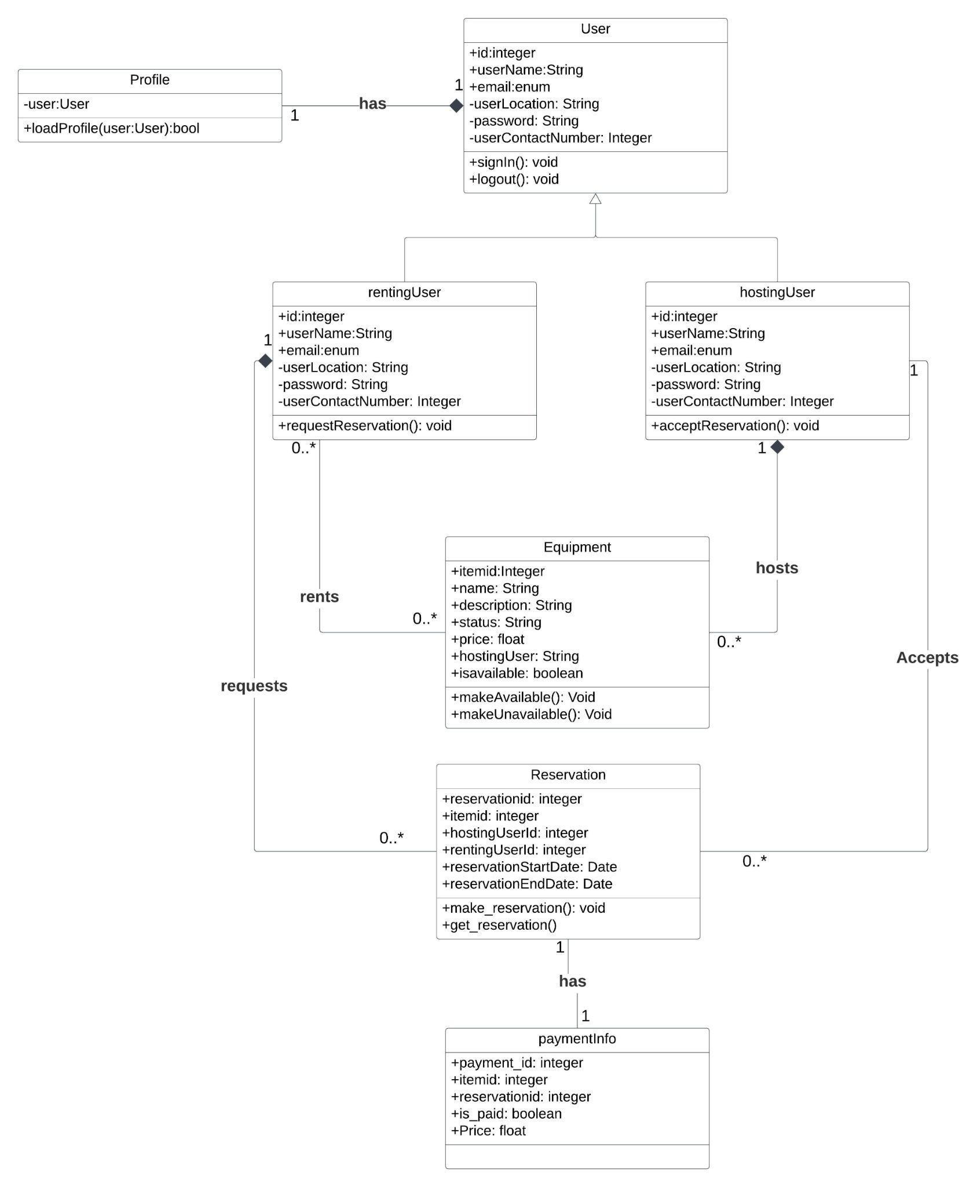
Class Diagram
Entities
User
rentingUser
hostingUser
Profile
Equipment
Reservation
Paymentinfo:

Slide 14
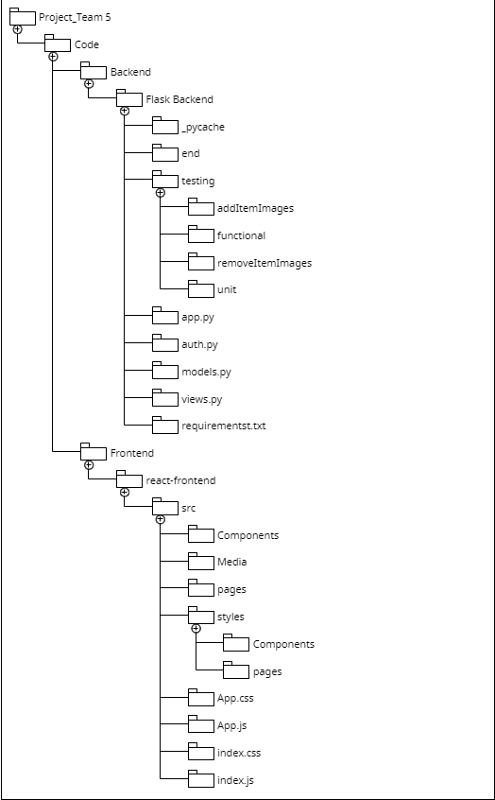
Software Architecture
Backend Components (Python Flask):
Flask Application: the core component of our backend.
API Routes: handle specific HTTP requests such as GET and POST.
Database Models: a relational database ElephantSQL using PostgreSQL.
Controllers (app.py): handle the business logic of our application.
receive requests from the API routes
interact with the database models
prepare data to send as responses.
Frontend Components (React.js):
React Application (app.js): This is the root component of our frontend application.
UI Components:. Each UI component represents a part of our application's user interface.
API calls: In our React app we make HTTP requests to the Flask API endpoints.

Slide 15
Database Structure & API Endpoints
Key Database Tables
User: Stores user information, including id, email, and password.
Equipment: Contains information about equipment listings, including itemid, name, description, status, price, owner, and available.
Reservation: Records user reservations, including reservation_id, start_date, end_date, item_id, user_name, price, and item_name.
Reviews: Stores user reviews, including target_username, origin_username, name, rating, and description.
/api/login
/api/dashboard
/api/profile /api/register
/api/register-google (
/api/login-google
/api/getEquipment
/api/addEquipment
/api/updateEquipment/<item_id>
/api/removeEquipment/<item_id>
/api/searchItems
/api/items
/api/makeReservation
/api/getReservation
/api/updateReservation/<reservation_id> reservation_id.
/api/removeReservation/<reservation_id> reservation_id.
/api/addReviews
/api/getReviews/<username>

Slide 16
Frontend Design Considerations
Modularization
Components based
Reusable Components
Error Handling
provide user-friendly error messages.
Security
Ensure that the API endpoints are protected and validate user input on the server-side
CSS Styling
Testing
Write unit tests and integration tests
Documentation
Add inline comments and documentation to improve code readability
Localization
Currently targeting U.S. customer with EST time zone
User Experience:
Continuously gather user feedback

Slide 17
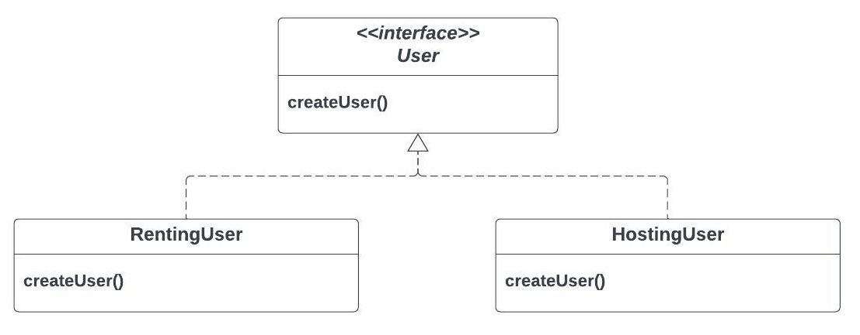
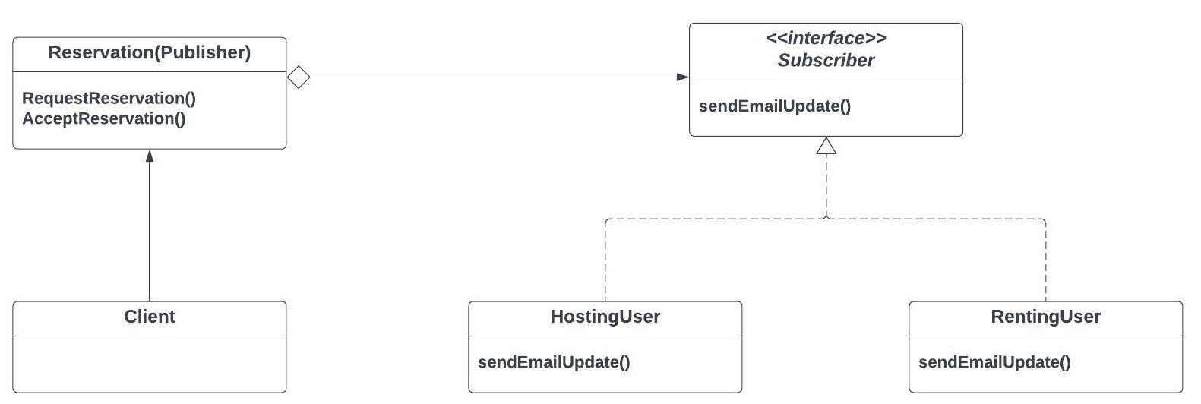
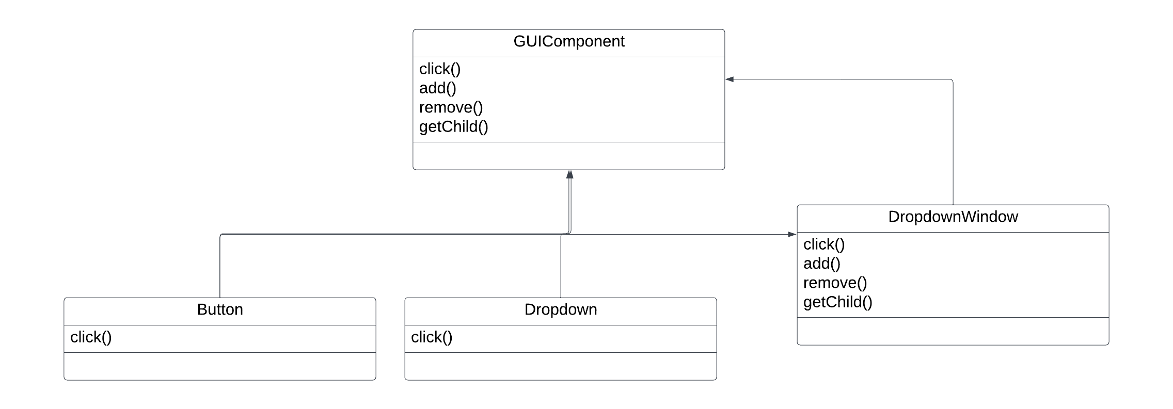
Design Patterns
Abstract Factory
creating an interface ‘User’
Observer
sending notifications to renting user and hosting user everytime a reservation has been requested or approved.
Composite
putting together frontend GUI components.

Slide 18
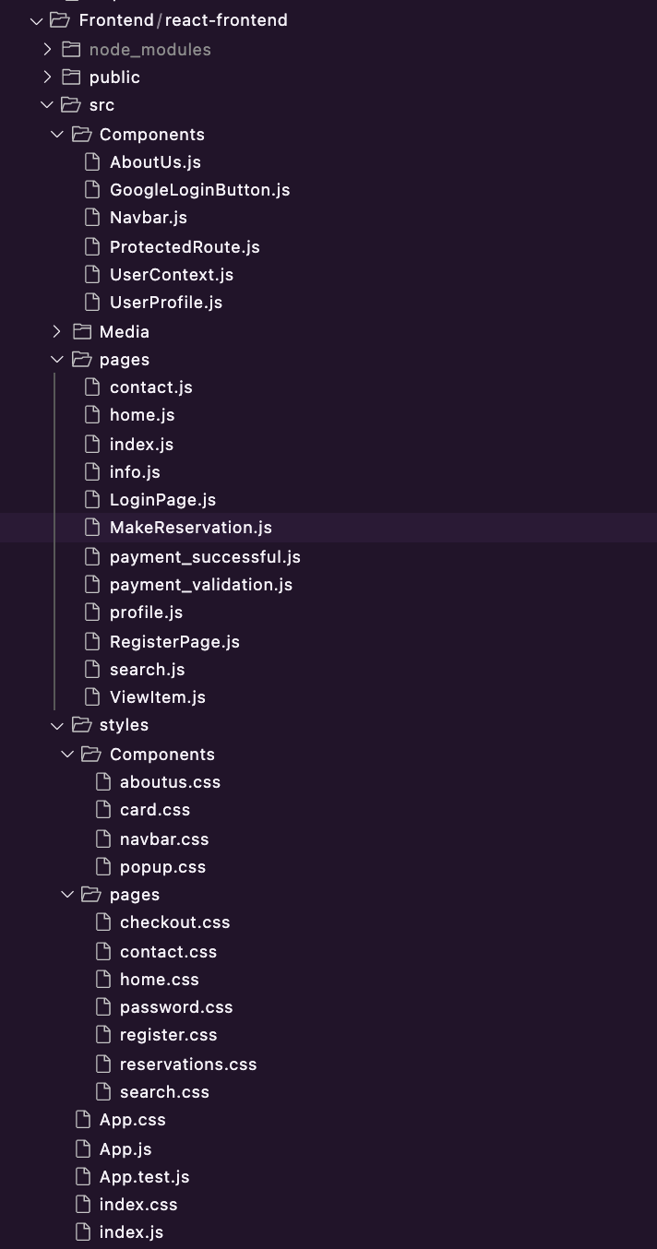
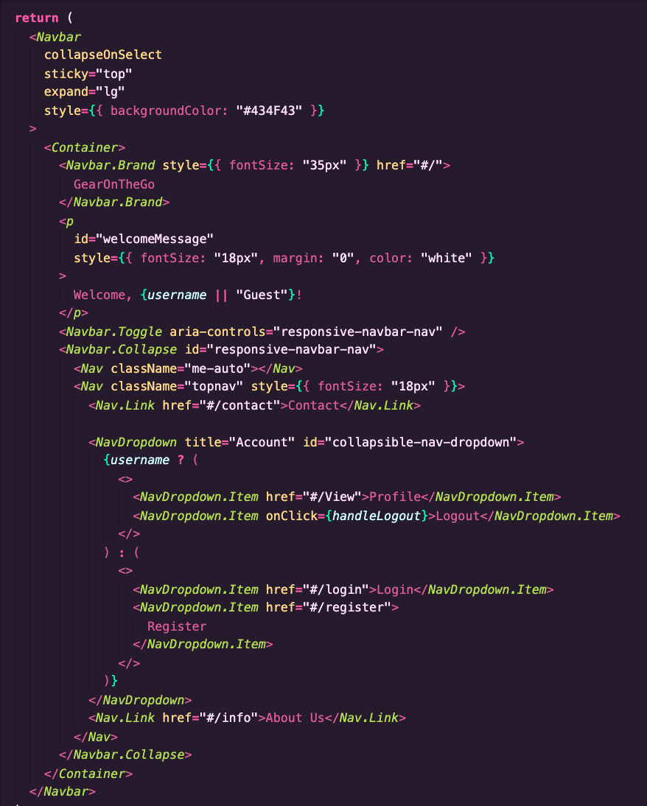
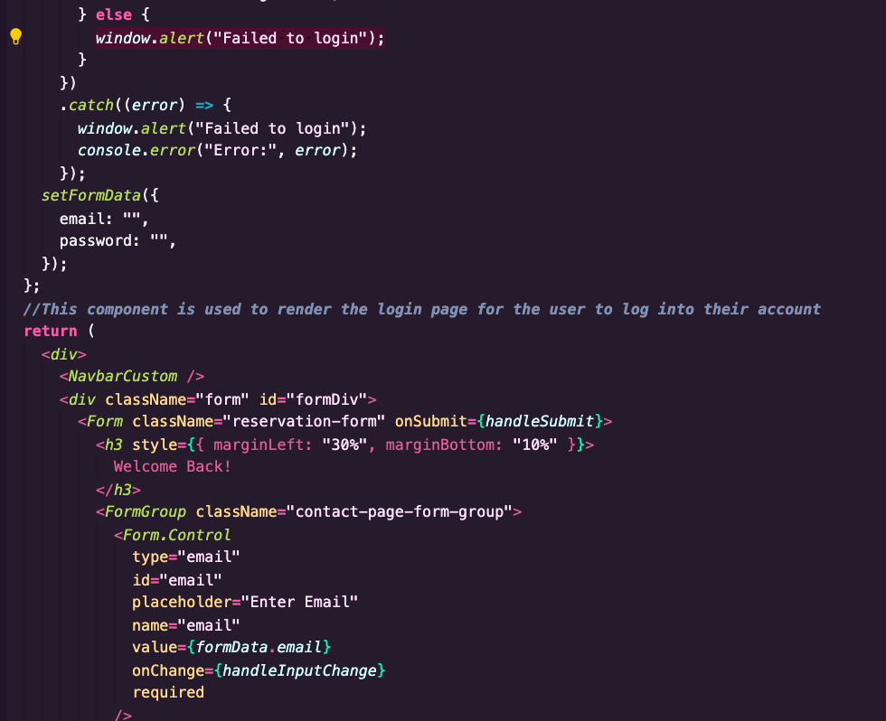
Implementation
Refactoring examples:
Duplicate Code
Unnecessary Comments
Dead Code
Long Method
Project Structure:
Component
Pages
Styles
Component - reused code
Navbar
Component used in every file rather than duplicating the code

Slide 19
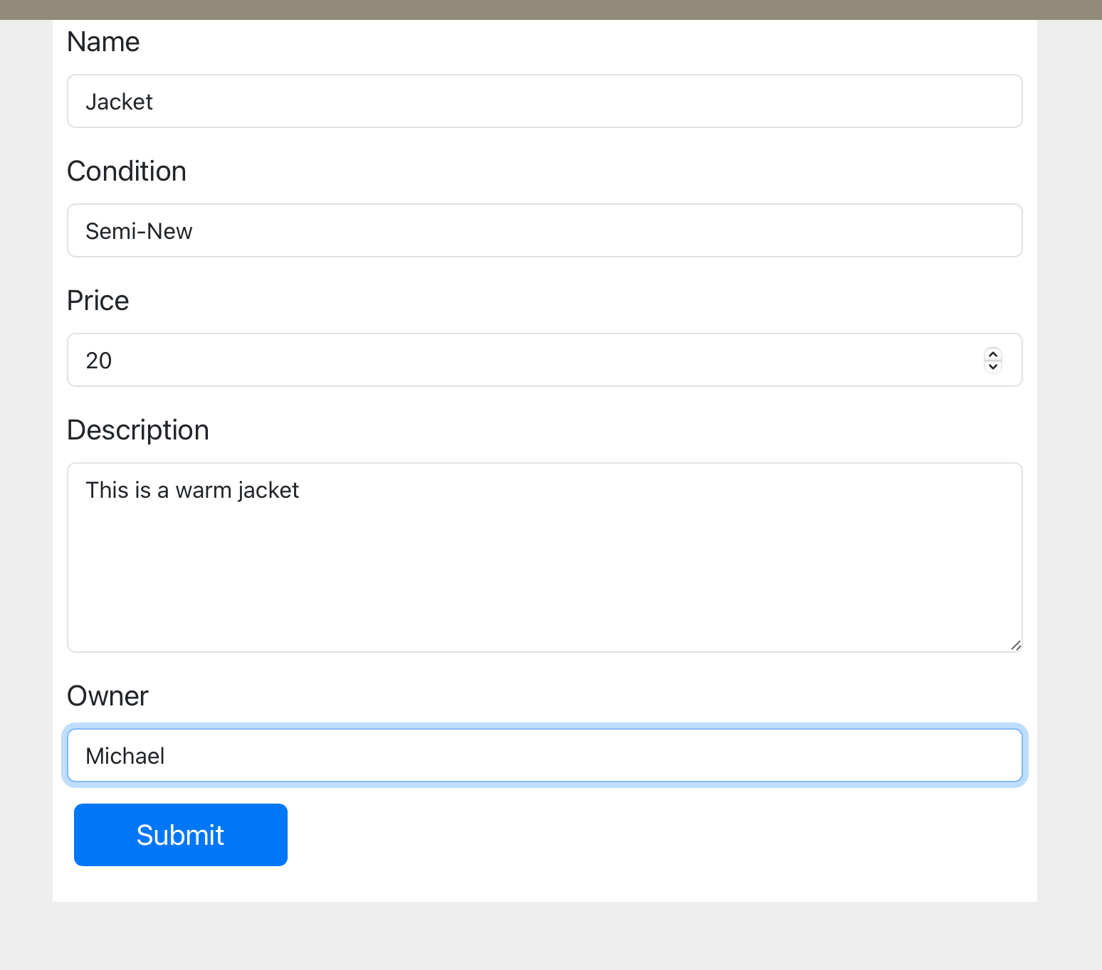
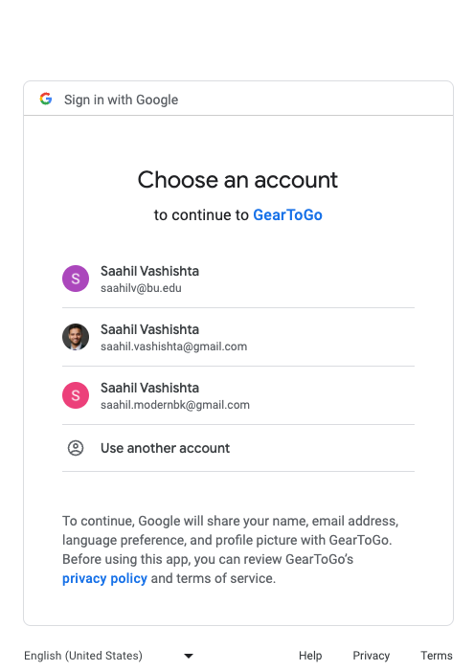
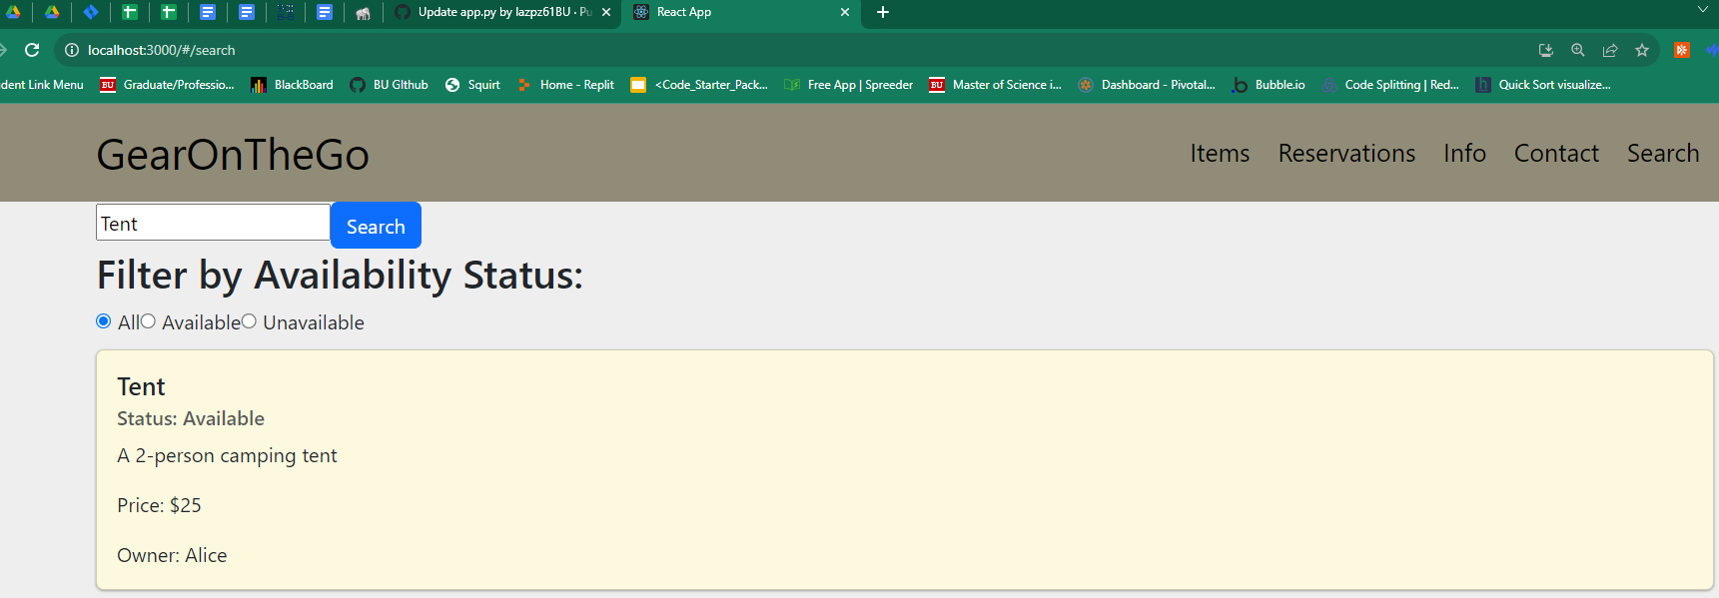
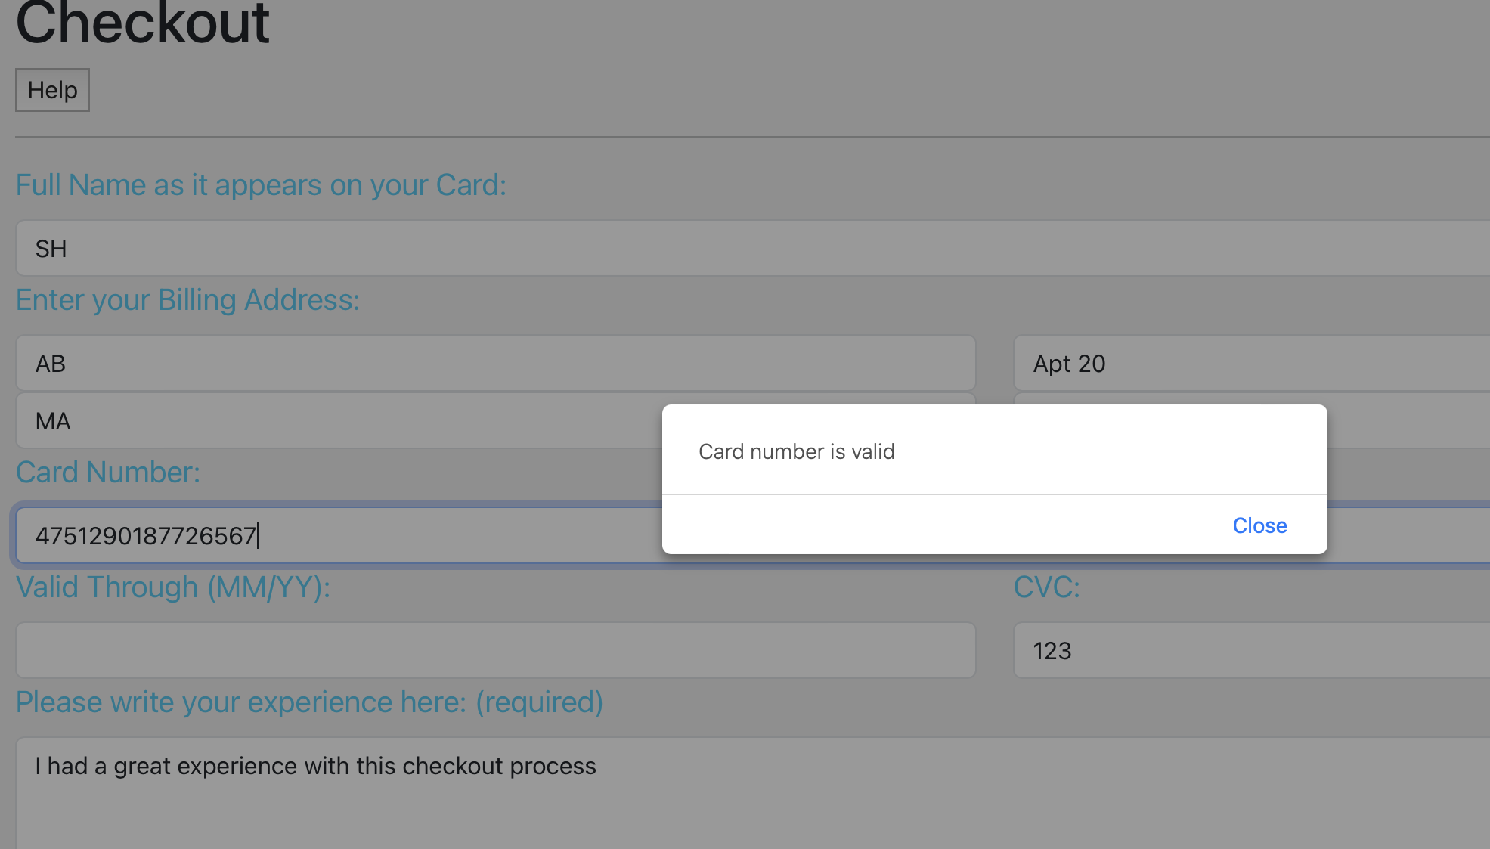
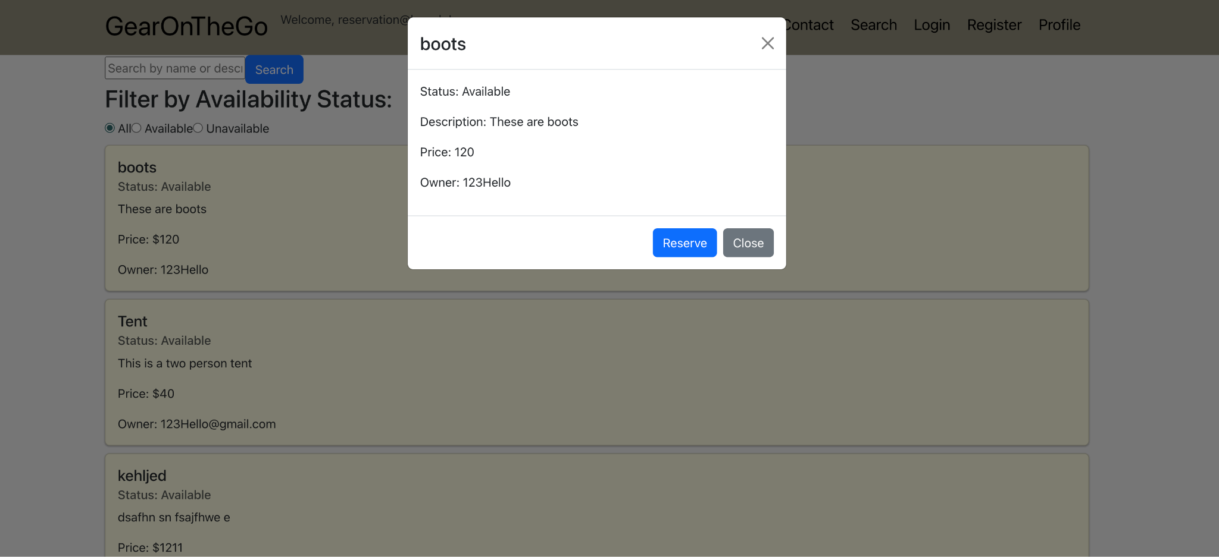
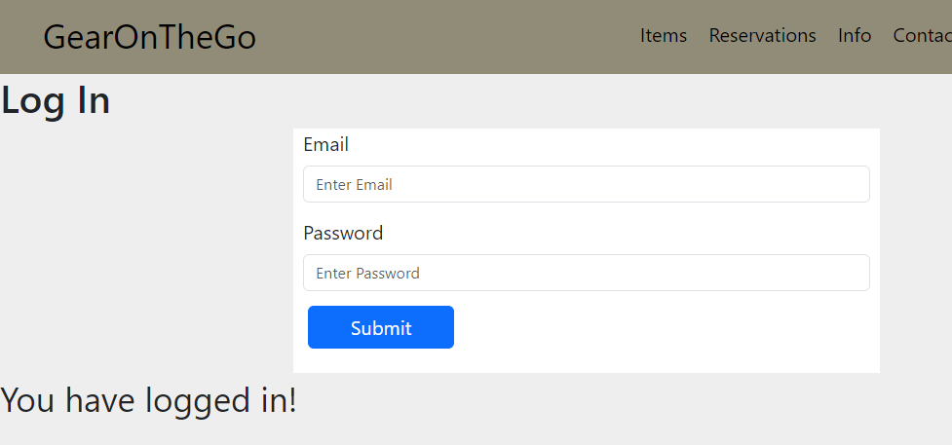
Types of Testing
Manual Testing:
-Google User Registration
- User Login
-Search Items
-Make Reservation Process
- Modify Cancel/Reservation Process
-Hosting Equipment
-Checkout Process
-Profile Pages and Reviews
Iteratively Performed(impl,pr’s,merges)

Slide 20
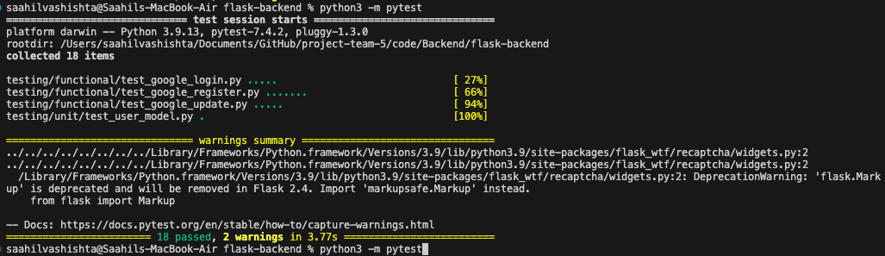
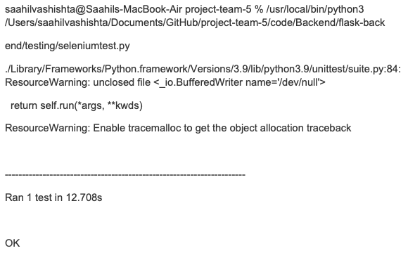
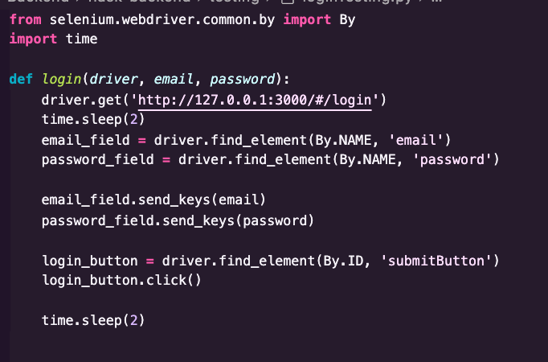
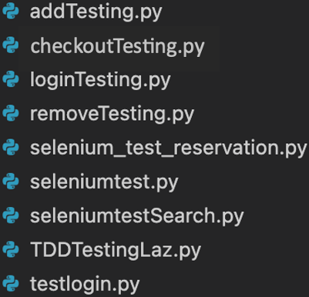
Types of Testing(cont)
Functional Testing:
Automated Testing:
User Reg, Login, Update- Pytest
Passes Selenium test for Google Email ID

Slide 21
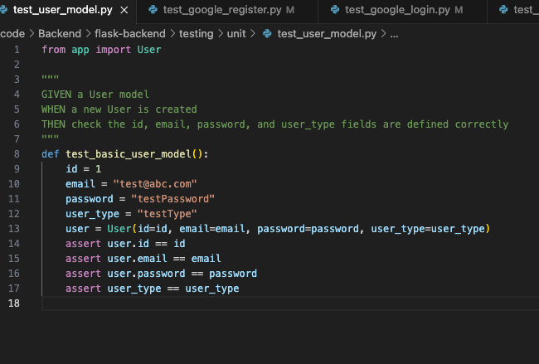
Types of Testing(cont)
Unit Testing
-Testing the User Database Table:

Slide 22
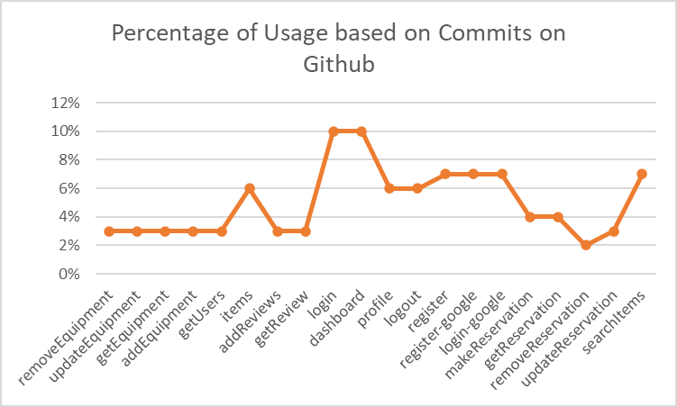
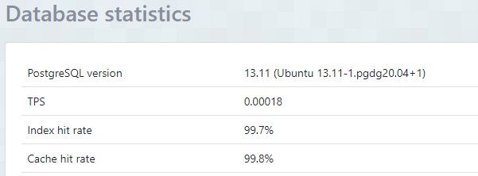
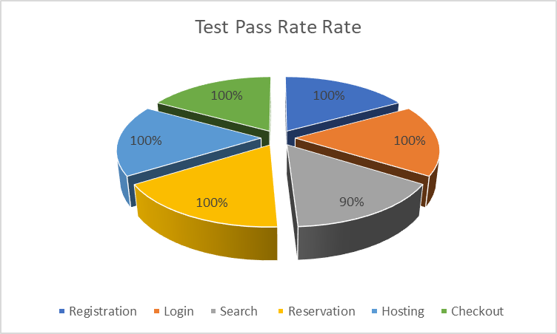
QA Metrics
Database Tables:
Api Metrics:
Test Pass Rate:

Slide 23
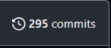
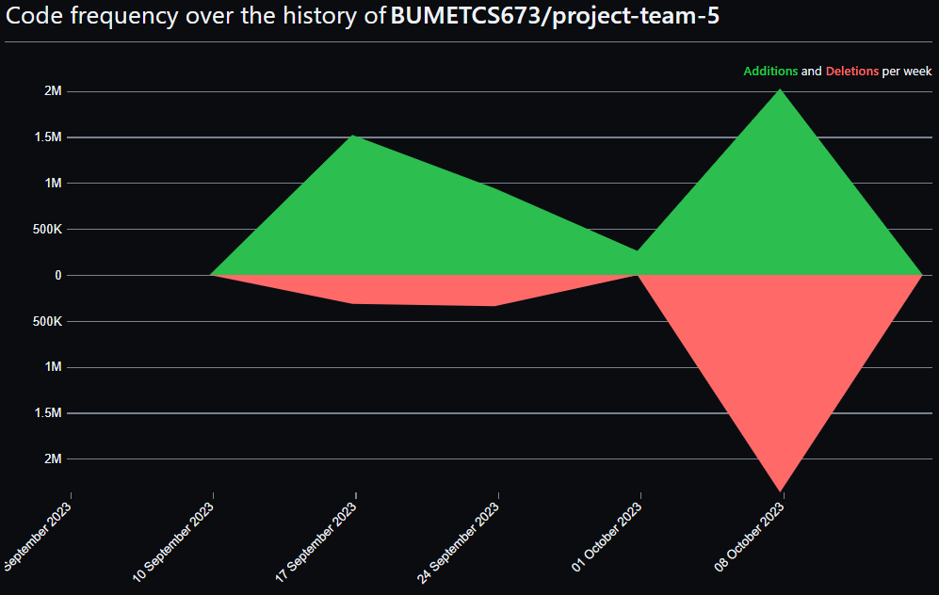
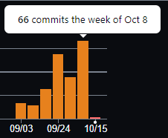
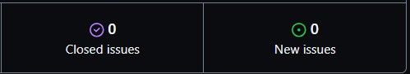
Code Coverage/Github Metrics
92 Merges
Code Frequency
Merge Conflicts/ Merge Resolutions

Slide 24

Security
Bcrypt
Hashing password and stored to database
Google Authentication
Server side authentication handled by Google’s robust security
User and Checkout Validation
User input validated for each field
Password Validation
Password validated to follow criteria
Logout and ending session
When User logs out, their session is ended and data cannot be retrieved unless logged in again
Routing
User can only access certain pages after logging in

Slide 25




Deployment - Heroku
Issues arose during deployment that were not foreseen until the last iteration while working on Netlify so we switched to Heroku.
We were able to work on getting the app hosted on Heroku. To access the link click here.
Lesson Take away: Hosting on a platform should have been done iteratively from Iteration 1, and continuous deployment and continuous integration should have been employed for this aspect of our team project. Heroku(not free) has functionality to continue to adjust the hosted project as more merges to main were conducted through each iteration. For a long time we were unable to successfully deploy our Project onto Heroku until the very end when we made it work.

Slide 26

Configuration
Help setup GitHub Desktop, IDE and other related dev tools, help others use these tools
Jira was used as a means to communicate our feature requirements and track our progress
Bootstrap in order to swiftly implement the visual of the website front end
Google oauth 3.0 for login and registration
Axios to aid in allowing the login process to work in conjunction with the rest of the website
Selenium was used for automated testing multiple pages and a variety of functionalities
ElephantSQL database to store login information, item information and reservation information
Netlify was initially being used to host the website but there were complications
Heroku for hosting the website

Slide 27
Project Management
Team Leader (Samantha)
Style
Add/Remove/Update Equipment
Profile Pages and Reviews
Navbar
QA Leader (Laz)
Search
Testing
Deployment
Security Leader (Ahnaf)
Login/Registration
Risk Management
Configuration Leader (Shajee)
Checkout
Requirements Leader (Saahil)
Google Authentication
About Us
Deployment
Design/Implementation Leader (Jay)
Reservation
Iteration Evolution
Iteration 0: Planning
Iteration 1: Implementation
Iteration 2: Testing/Extra Features
Iteration 3: Styling/Deployment
Risk Management
All Risk are closed
Requirements:
Completed all Essential features
Desirable Features: Ratings, Price filter
NonEssential: Password Encryption
Features not completed:
Email Notification
Location
Images for items
Chat Bot
Lessons Learned:
Communication is key
Team Collaboration
Broader Picture of the Software Engineering Process
Allocate more time for testing
Challenges:
Merging using Git
Learning Selenium
Passing the Username from logging in to be used in any page
Logic for the Ensuring Keyword Searches and Price Filtering can be used simultaneously
Deployment was an issue since we didn’t program based on requirements from Heroku or Netlify
Google OAuth was extremely sensitive to change and caused errors multiple times

Slide 28
Thank you!

